Slide 1

Sensor Kit (Kit 1)
ZAS Robotics Training

Slide 2



Sensor Kit - Contents
Sensor Kit Components
Sensor Creative Board

Slide 3




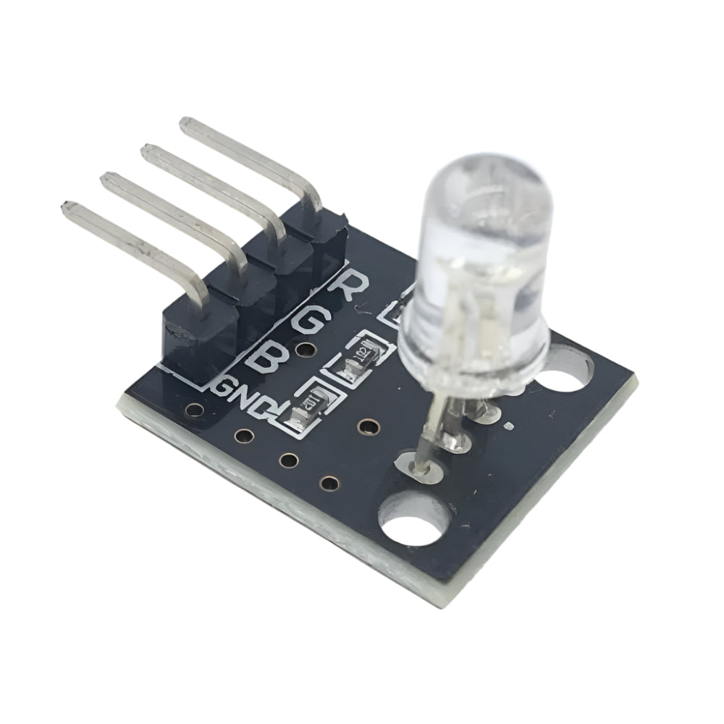
SFL04: USING RBG LIGHTS
Things needed

Slide 4
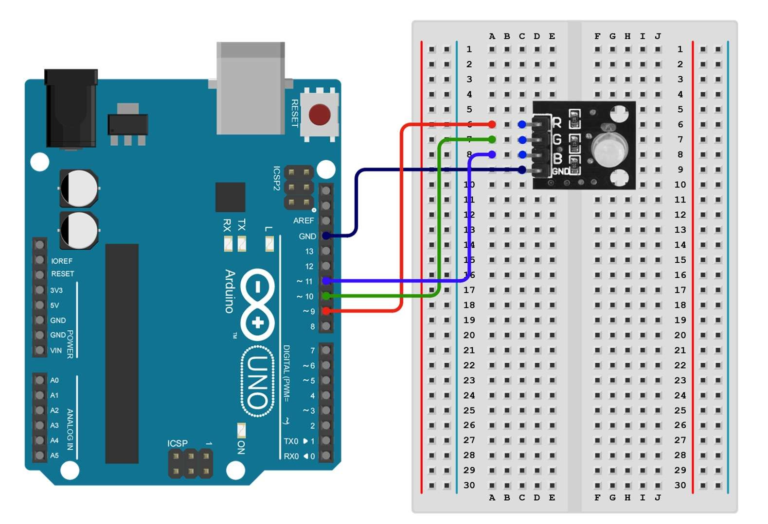
SFL04: USING RBG LIGHTS
Connections:
Arduino pins | Bread board (RGB sensor)
GND | GND(violet line)
Digital pin 9 | R(red line)
Digital pin 10 | G(green line)
Digital pin 11 | B(blue line)

Slide 5
SFL04: USING RBG LIGHTS
Setup()
connect RGB sensor pins
R – digital pin 9
G – digital pin 10
B – digital pin 11
Loop()
to control the colour output using a microcontroller, and how to create various colours by adjusting the intensity of each colour channel.
Code for Lesson SFL04:
https://github.com/info-zas/zas-robotics-sensors/blob/main/01_FoundationProjects/01_Code/_04_ColorMixingWithRGBLEDusingPWM/_04_ColorMixingWithRGBLEDusingPWM.ino

Slide 6
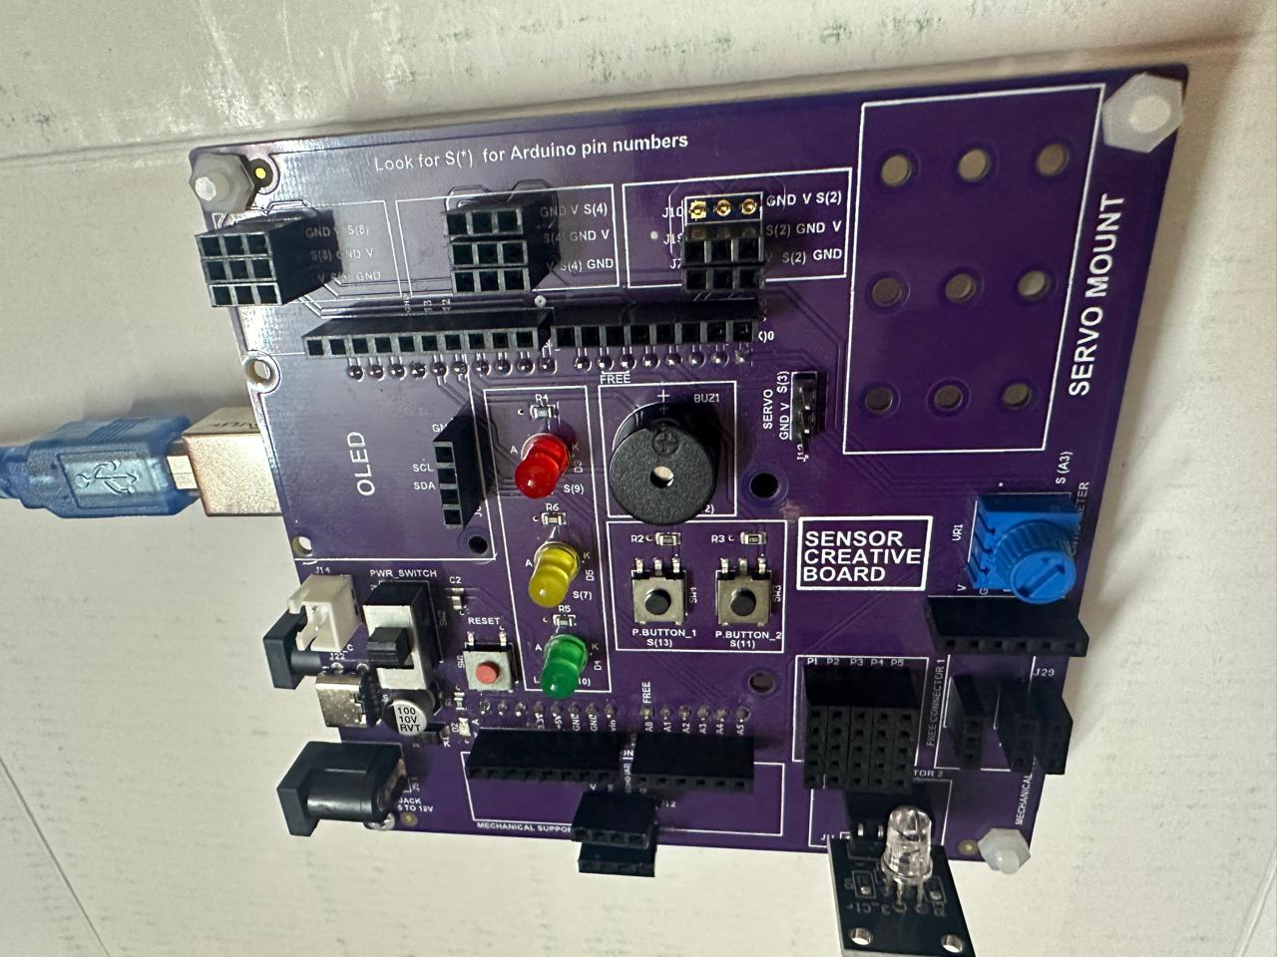
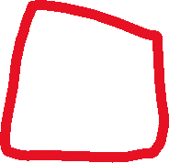
SFL04: USING RBG LIGHTS
The creative board already has built-in LED lights.
For RGB sensor we can connect to free connector or four pin slot J11 or J14 and define pins in the code
This setup removes the need for additional wiring.
The design prevents wire clutter and keeps the workspace neat.
It lets users focus more on the project rather than wiring.
Ideal for beginners learning Arduino without hassle.

